Slide 1
線上申請工作證詳細流程
How to apply for Work Permit online

Slide 2
申請帳號流程
Apply for Account

Slide 3
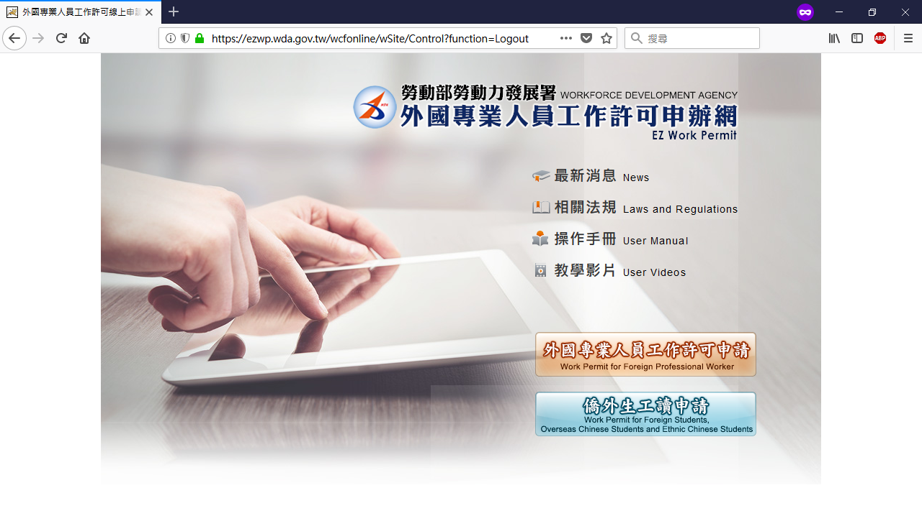
點擊「僑外生工讀申請」按鈕
Click The Button

Slide 4
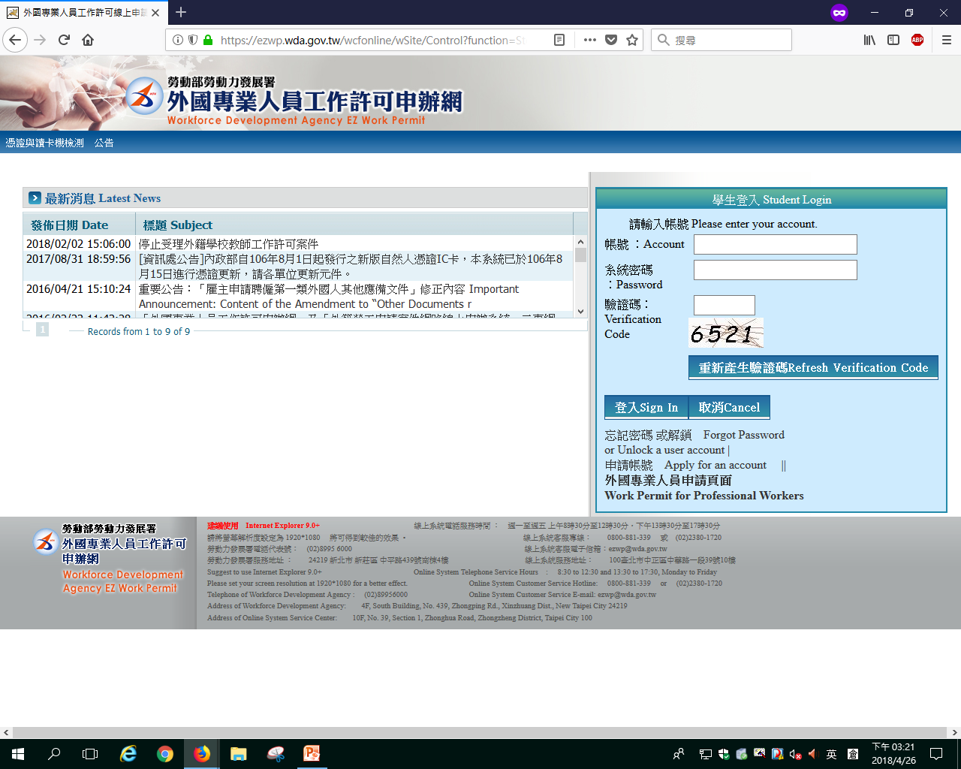
點擊「申請帳號」
Apply for Account

Slide 5
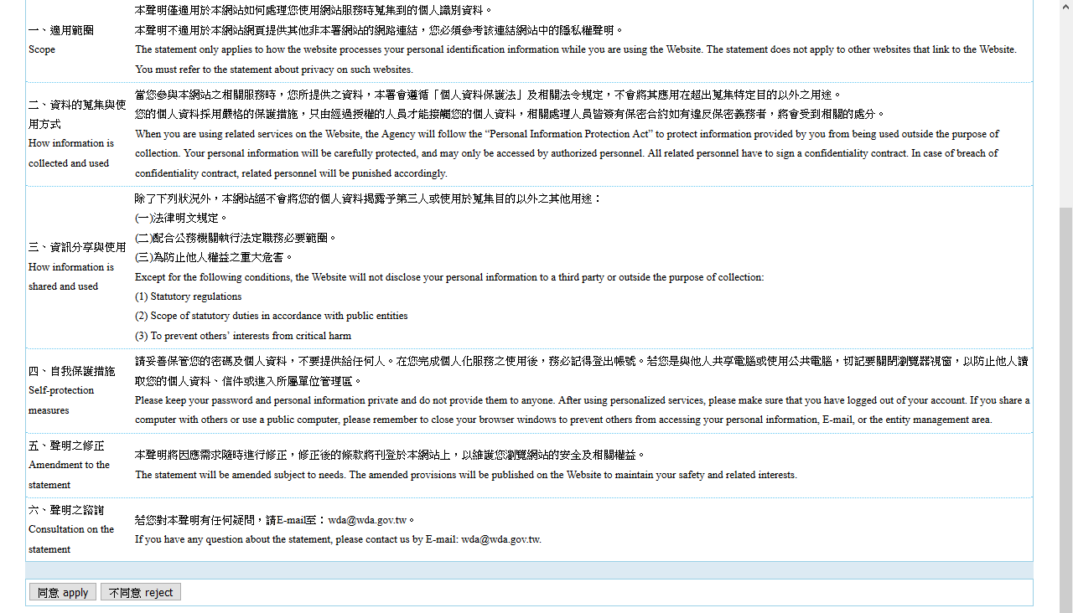
點擊「同意」按鈕後繼續
Click the button of “Apply”to continue

Slide 6
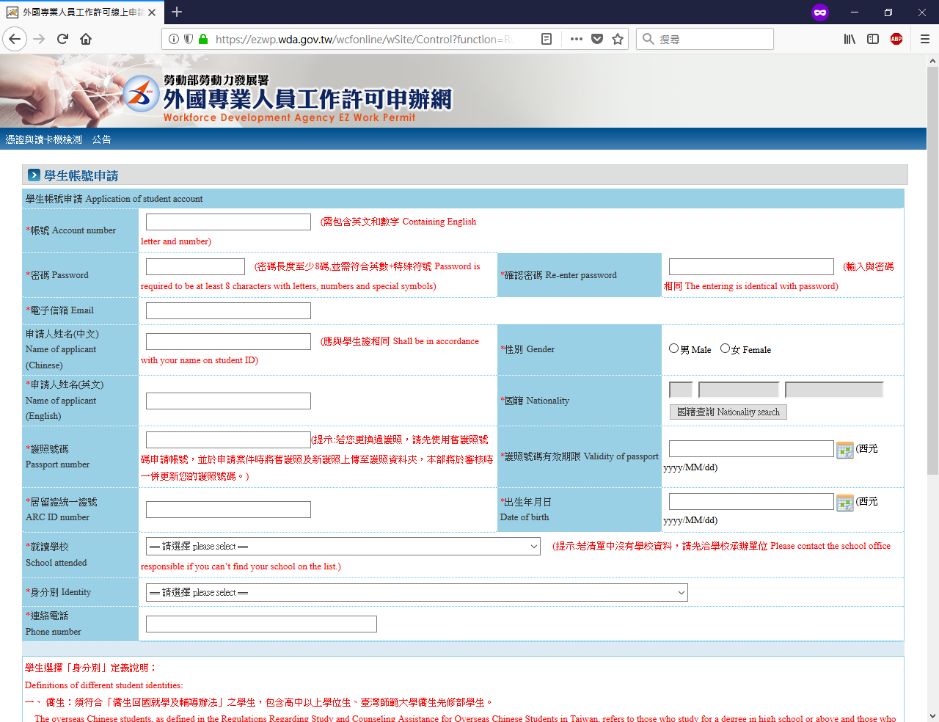
請填妥所有欄位
Fill in all of the forms
點擊「確定」按鈕後就完成
Click the Button of Submit to Finish it!

Slide 7
申請工作證流程
Apply for Work Permit

Slide 8
需準備並上傳之文件
申請帳號後進行工作證申請，請將匯款後收據上相關資料填上網頁。（如以ATM繳費請選＂繳費＂，而不是轉帳功能）
學生證正反面影本加蓋當學期註冊章或另附在學證明（PDF檔上傳於申請資料夾）
有效護照資料頁及居留證影本（PDF檔上傳於申請網址資料夾）
僅外籍生需上傳工作理由說明並至國際處蓋章後上傳於申請資料夾
The required documents
Login your work permit account & apply online. Please type the receipt number, date for payment and Post Office’s branch number on the application page. (For the ATM payment, please select "Bill Payment" function; not the "Fund Transfer" function.)
Uploading the student ID (both sides) with a current semester’s registered stamp or an enrollment certificate (PDF).
Uploading your passport information page & both sides of ARC.
Only International students need to provide the reason for work and get the stamp by OIA office

Slide 9
點擊「僑外生工讀申請」按鈕
Click this button

Slide 10
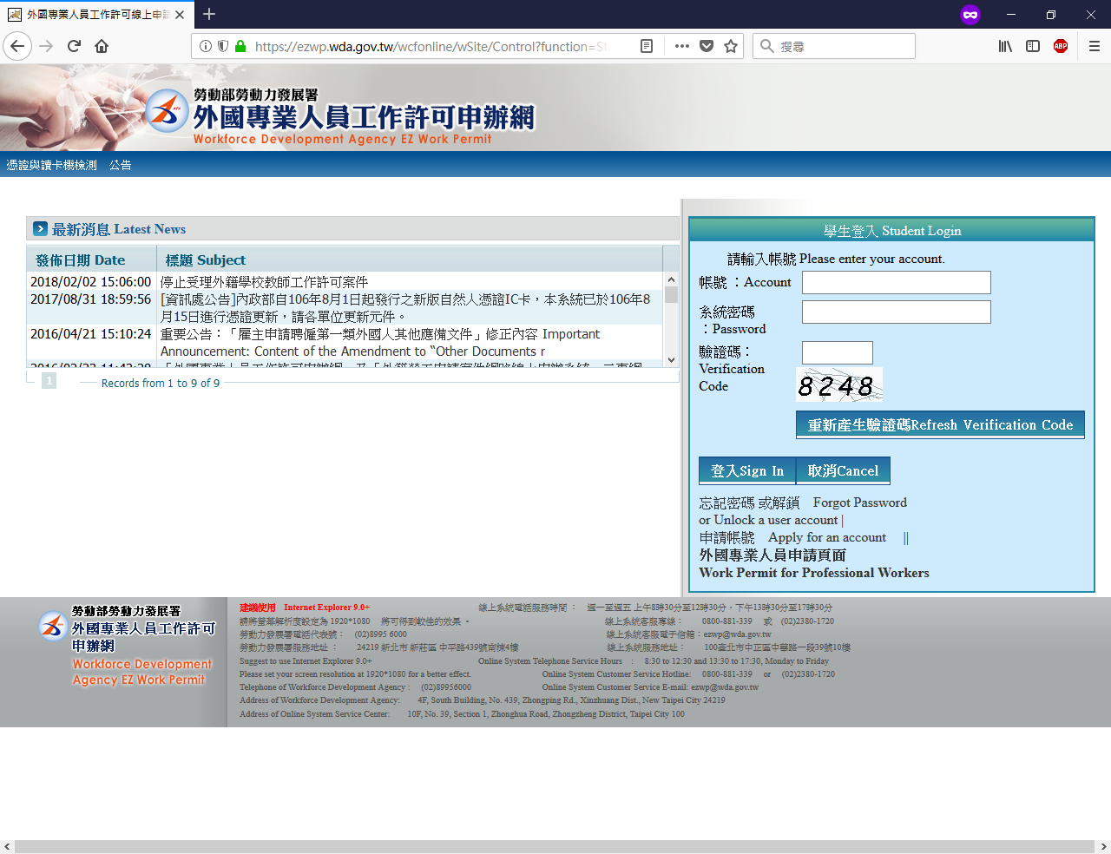
請登入後再繼續Sign in

Slide 11
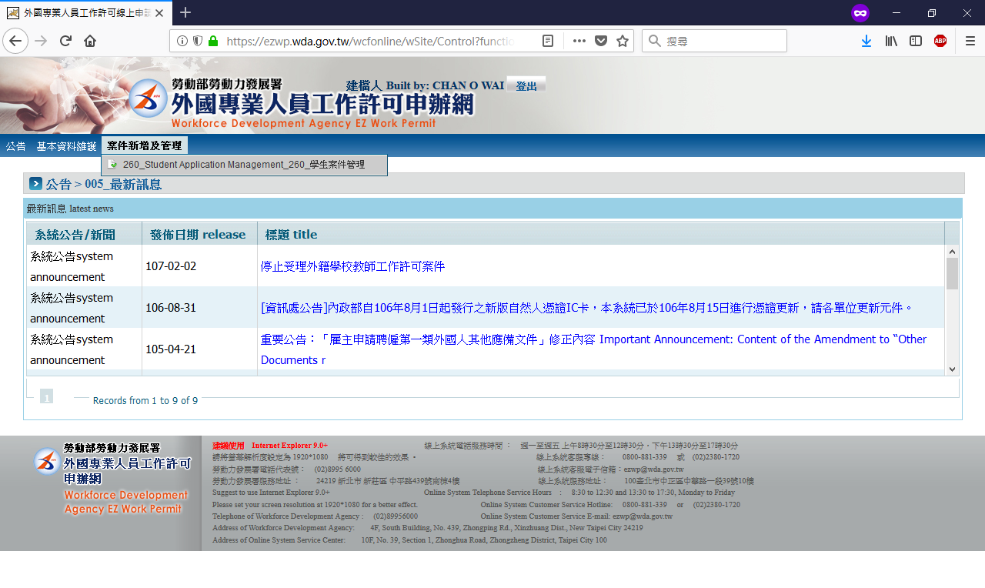
首先滑到「案件新增及管理」欄
之後再點擊「學生案件管理」按鈕
Click the button of
“Application Management”

Slide 12
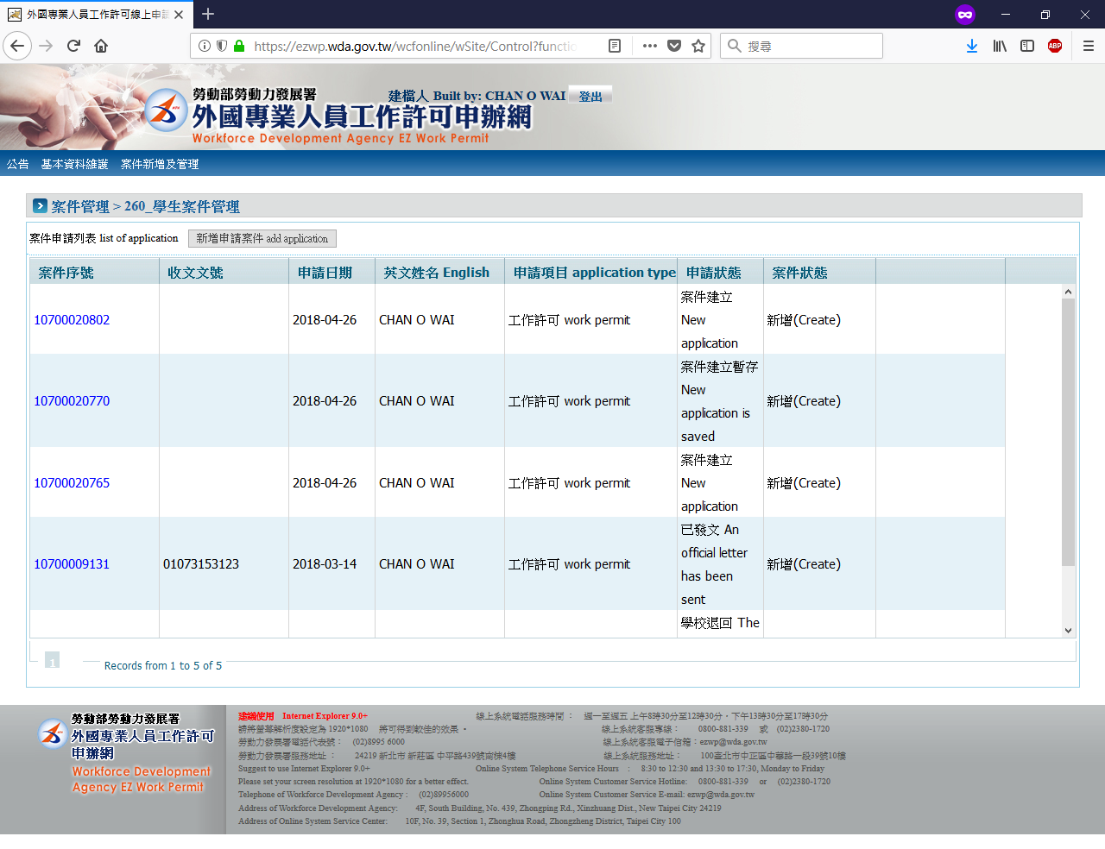
點擊「新增申請案件」按鈕
Click the button of
“Add Application”

Slide 13
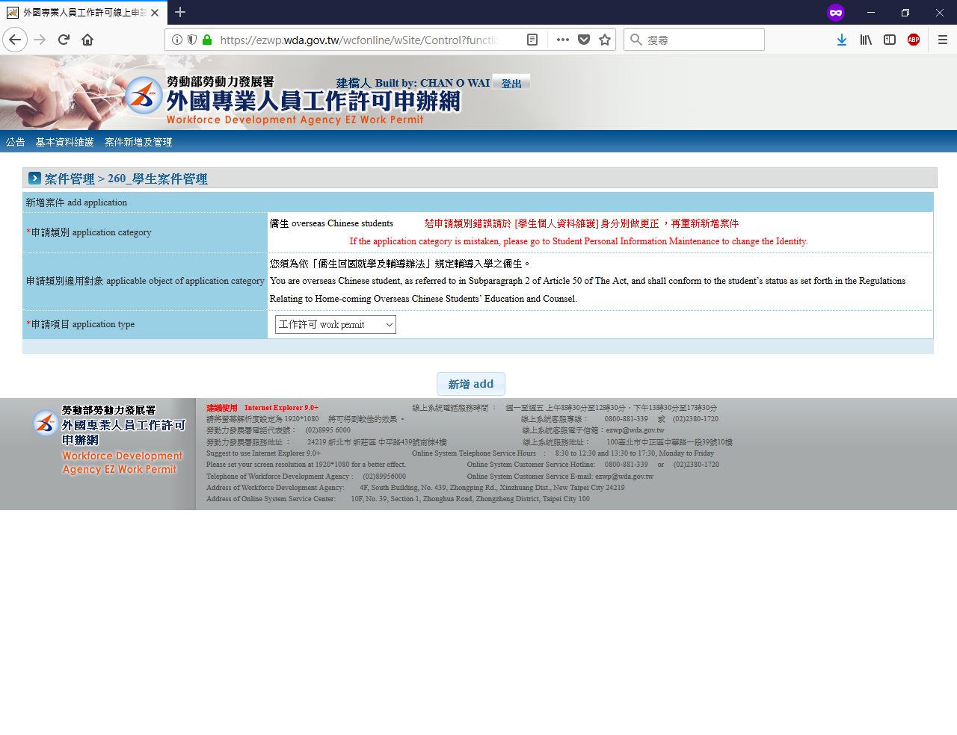
從清單中選擇「工作許可」項目然後再點擊「新增」按鈕
Choose the “Work Permit” from the list and click the button of “add”

Slide 14
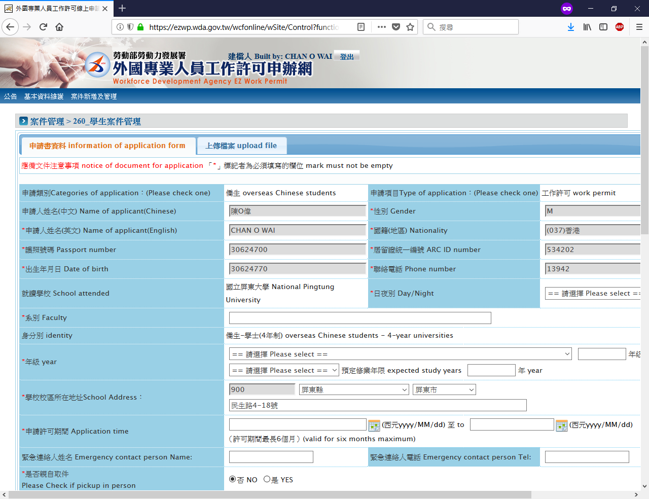
請填妥所有欄位
Fill in all of the forms
這裡選取「否」選項
Choose “No”

Slide 15
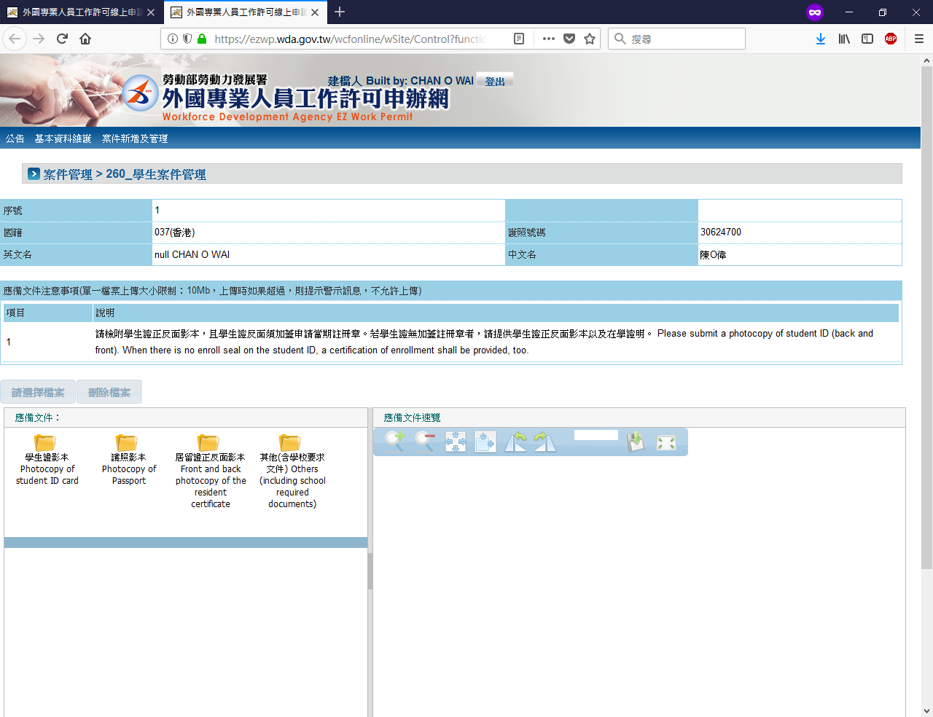
*1.外籍生需要附上工作理由並經國際處蓋章International students need to provide the reason for work and get the stamp by OIA office
2.劃撥收據上傳的地方
2.Upload the remittance receipt here.
上傳所需檔案
Document Preparation
上傳完成後請點擊「確認」按鈕
After upload documents, click the button to submit

Slide 16
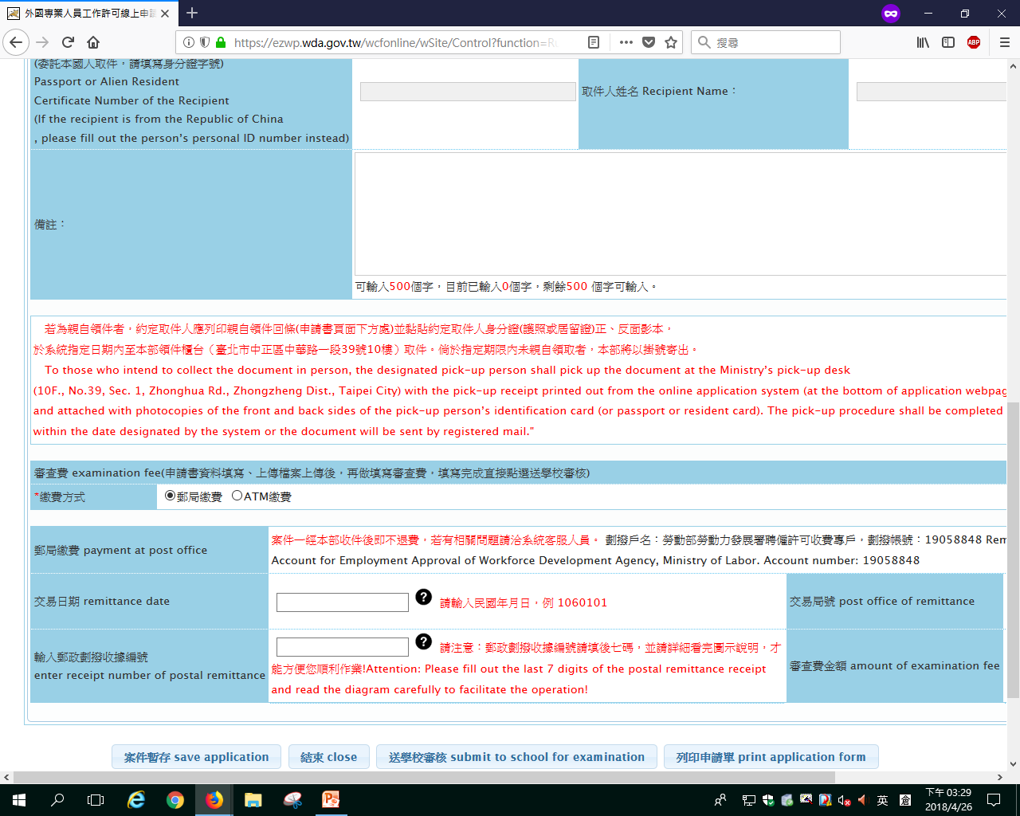
如果以郵局劃撥方式繳費請選取「郵局劃撥」選項，並請先到郵局劃撥
If you choose to pay the fee by post office ,please go to the post office to pay the fee first.
然後請填妥劃撥資料，並把收據掃瞄上傳。
Fill in the information of remittance and upload the receipt

Slide 17
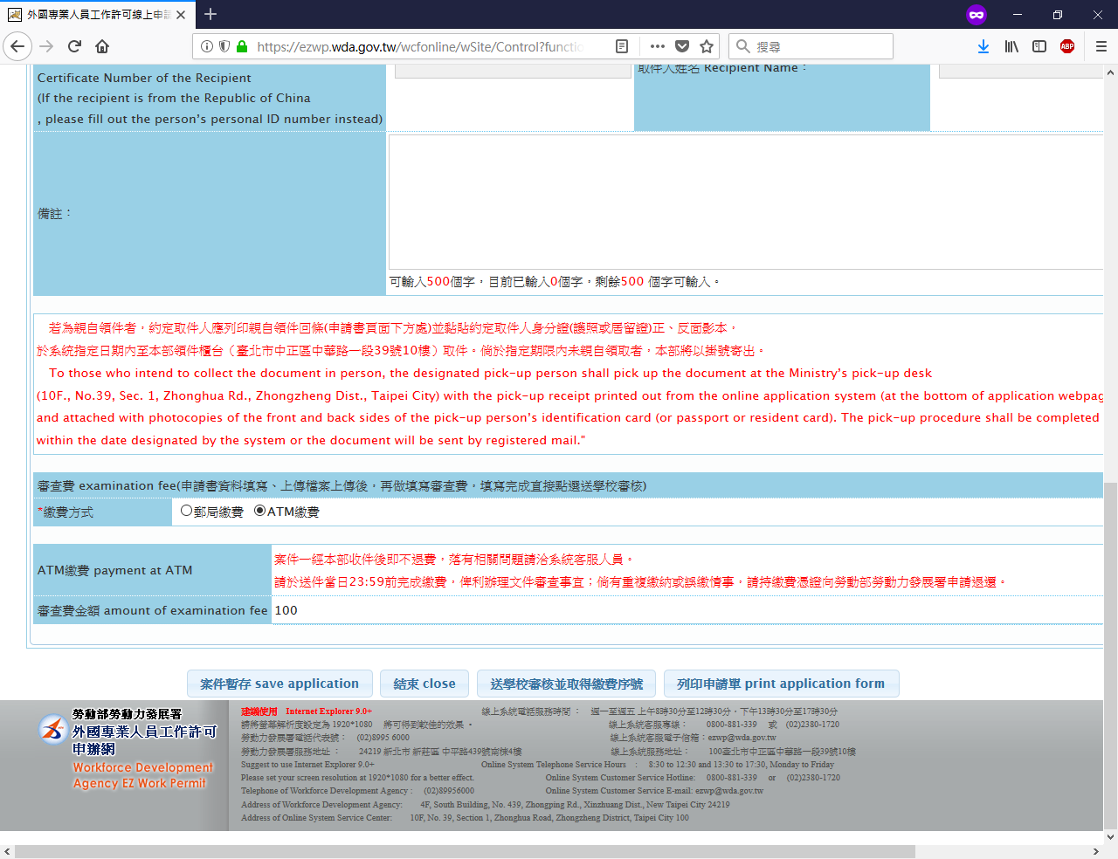
如果以ATM繳費請選取「 ATM 繳費」選項
If you pay the fee by ATM, choose the “ATM”.
最後確保資料無誤後點擊「送學校審核並取後繳費序號」按鈕
Double check the information and click “submit to school for examination and get the number of remittance”

Slide 18
學生證格式 Format of Student ID card
影印之後到註冊組蓋在學證明章！！！
Copy the student ID card and go to the registration office to stamp the certificate of enrollment!!!

Slide 19
工作證效期：
於上學期提出者，工作許可之期限原則至次學期之3月31日止。
於下學期申請者，工作許可之期限原則至同年之9月30日止。
申請之許可期間較短者，將依其申請期限核予許可，考量學生之工讀需求不一，仍依其申請期限為準，惟最長仍以6個月為限。
應屆畢業生（含延畢生）工作許可期限至同年6月30日止。學生若有暑修或延畢之需要，由學校註冊組出具相關證明，或考取研究所則加附由錄取學校出具該生已完成報到手續之證明文件即可申請延長許可期限至同年9月30日。

Slide 20
There are 2 terms of work permit period
For applications made in the first semester (fall semester), the work permit is valid until March 31st of the next semester.
For applications made in the second semester (spring semester), the work permit is valid until September 30th of the same year.
Because requirements for each student’s part-time job are different, validity periods of the work permits are based on the applications, but the longest period is 6 months.
Work permits for university/college graduates (including students whose graduation is delayed) are valid till June 30 of the same year. Students who delay their graduation must present the relevant proof document issued by the school. Students already admitted to a university or graduate school should attach a document stating that he/she has completed the registration procedure issued by the school so that they may apply to extend the valid period of their work permit to September 30 of the same year.

Slide 21
外籍人士之工作時間除寒暑假外，每星期最長為二十小時。International students are allowed to work at maximum 20 hours per week during regular semesters. This limit is except for winter and summer vacations.
請每天注意系統的案件申請狀態，如果有出現「已發文」的狀態就是勞動部審核通過了。Please pay attention to the status of the case on application system. If there shows status of“an official letter has been sent", it means that the case has passed .

